Slide 1
TEXT RECOGNITION USING OCR

Slide 2
INTRODUCTION
WHAT IS OCR ?
Stands for "Optical Character Recognition." OCR is a technology that recognizes text within a digital image. It is commonly used to recognize text in scanned documents.OCR software processes a digital image by locating and recognizing characters, such as letters, numbers, and symbols.
This involves photo-scanning of the text character-by-character, analysis of the scanned-in image, and then translation of the character image into character codes, such as ASCII, commonly used in data processing. The OCR function provides an easy way to add text recognition functionality to a wide range of applications.

Slide 3
PROBLEM STATEMENT
To recognise the text from raw image(which is not preprocessed) .
To implement one application after recognising the text from the image(translation to different languages in our project).
To segment the image to individual characters,we need to find the characteristic to be used as boundary to segment the image.
Ocr can’t be applied on raw image. We need to process the image first to get the maximum accuracy and our project is based on this.

Slide 4
LITERATURE SURVEY
The papers refered were as follows:
1.)Text Detection and Character Recognition in Scene Images with Unsupervised Feature Learning : Adam Coates, Blake Carpenter, Carl Case, Sanjeev Satheesh, Bipin Suresh, Tao Wang, David J. Wu, Andrew Y. Ng Computer Science Department Stanford University 353 Serra Mall Stanford, CA 94305 USA
In this paper they have produced a text detection and recognition system based on a scalable feature learning algorithm and applied it to images of text in natural scenes. They demonstrated that with larger banks of features we are able to achieve increasing accuracy with top performance comparable to other systems, similar to results observed in other areas of computer vision and machine learning.

Slide 5
2.)Multi-script Text Extraction from Natural Scenes : Llu ́ıs Gomez and Dimosthenis Karatzas ́Computer Vision Center Universitat Autonoma de Barcelona.
I this paper a new methodology for text extraction from scene images was presented, inspired by the human perception of textual content, largely based on perceptual organisation.It is totally independent of the language and script in which text appears, it can deal efficiently with any type of font and text size, while it makes no assumptions about the orientation of the text.

Slide 6
3.)Real-Time Scene Text Localization and Recognition : Luka ́s Neumann Ji ˇ ˇr ́ı Matas Centre for Machine Perception, Department of Cybernetics Czech Technical University, Prague, Czech Republic.Published at the 25th IEEE Conference on Computer vision and Pattern recognition , CVPR 2012 , June 16-21 , Providence , RI , USA.
An end-to-end real-time text localization and recognition method is presented in the paper. In this the probability of each ER being a character is estimated using novel features calculated with O(1) complexity and only ERs with locally maximal probability are selected .The classification is improved using more computationally expensive features.

Slide 7
DRAWBACKS :
OCR software is useful for converting scanned images of typed or handwritten documents to searchable electronic text, but it has disadvantages that limit its applications. The following are the disadvantages :
Limited Documents: OCR works best with good quality typed documents. Handwritten documents cannot be easily read by OCR software. Likewise, typed fonts that resemble handwriting -- as well as non-Latin fonts -- create many errors during the OCR process.
Accuracy: No OCR software is 100 percent accurate. The number of errors depends upon the quality and type of document, including the font used. Errors that occur during OCR include misreading letters, skipping over letters that are unreadable, or mixing together text from adjacent columns or image captions
NO PRE-PROCESSING of the image: Directly OCR has been applied and implemented.
NO APPLICATIONS Were Made.

Slide 8
SYSTEM REQUIREMENT
Operating System : Ubuntu
Coding Language : Python
Libraries Used: OpenCV, Goslate, pytesseract, NumPy, Unicodedata.

Slide 9
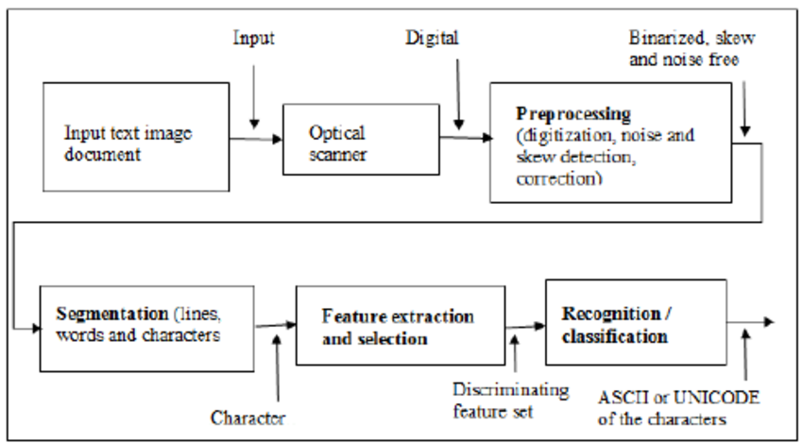
FLOWCHART:

Slide 10
ALGORITHM:
1.)Input the image
2.)Convert the image to grayscale
3.)Apply dilation and erosion
4.)Threshold the image
5.)Apply salt and pepper filter to remove the noise
6.)Apply median blur
7.)Use OCR to extract text

Slide 11
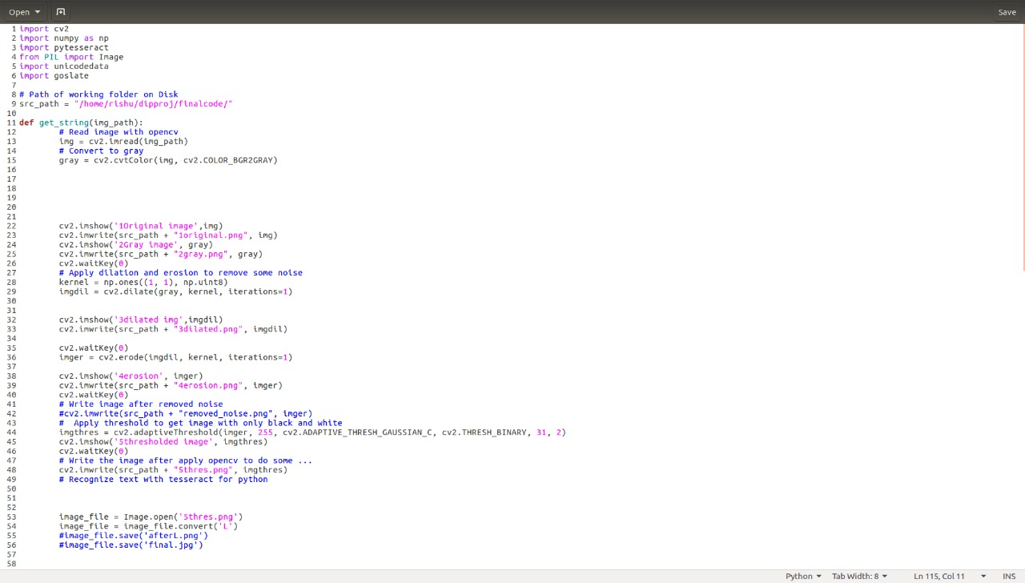
IMPLEMENTATION

Slide 12
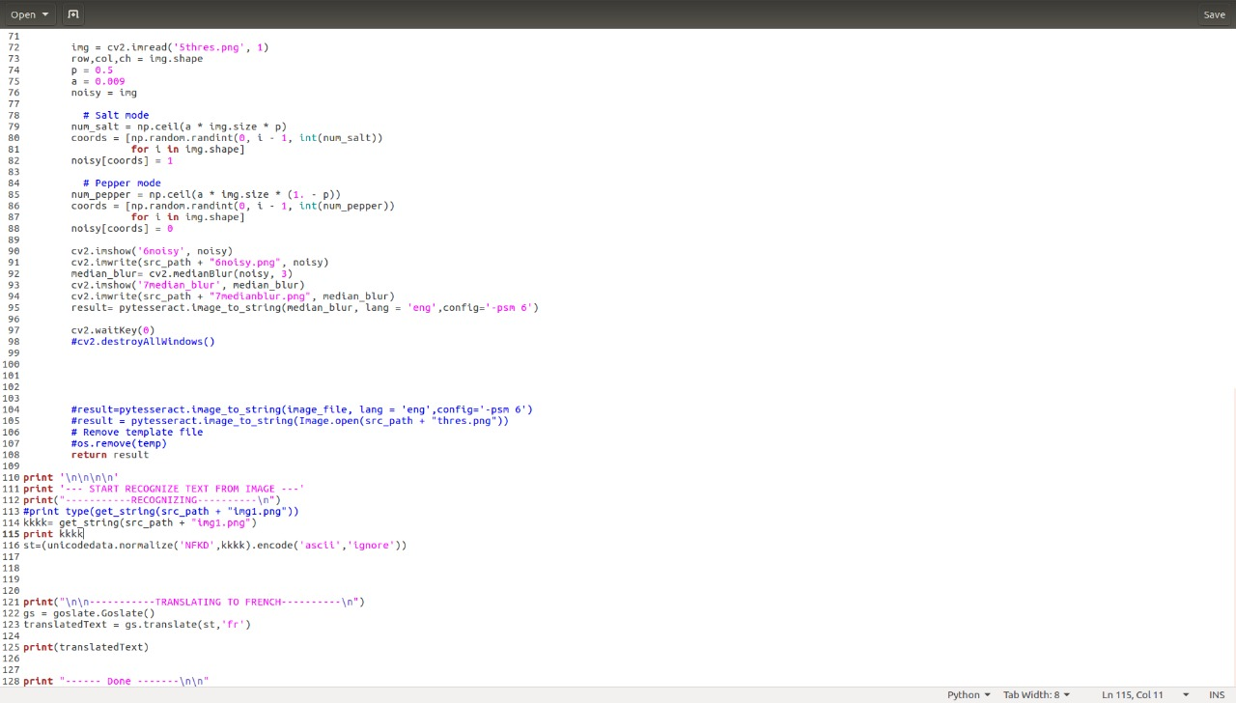

Slide 13
PROS and CONS:
OCR reduces time for processing data from large number of forms. If done manually, may lead to human error and takes up much of the time.
Recognition of cursive text is an active area of research, with recognition rates even lower than that of hand- printed text. Higher rates of recognition of general cursive script will likely not be possible without the use of contextual or grammatical information.

Slide 14
CONCLUSION:
The objective of this paper is to segment and recognize characters in image have been achieved. Even the segmentation accuracy from the experiment is 100% the result during real application may be lower due to limited set of picture used in experiment.
OCR technology provides fast, automated data capture which can save considerable time and labour costs of organisations
The system has its advantages such as Automation of mundane tasks, Less Time Complexity, Very Small Database and High Adaptability to untrained inputs with only a small number of features to calculate.

Slide 15
FUTURE SCOPE:
• New features can be added to improve the accuracy of recognition.
• The proposed work can be extended to work on degraded text or broken characters.
• Recognition of digits in the text, half characters and compound characters can be done to improve the word recognition rate.
• An android application can be implemented to do real time translation using ocr and algorithms we have implemented.(For the Application that we specified in our project)

Slide 16
BIBLIOGRAPHY
[1] Chen, Huizhong, et al. "Robust Text Detection in Natural Images with Edge-Enhanced Maximally Stable Extremal Regions." Image Processing (ICIP), 2011 18th IEEE International Conference on. IEEE, 2011.
[2] Gonzalez, Alvaro, et al. "Text location in complex images." Pattern Recognition (ICPR), 2012 21st International Conference on. IEEE, 2012.
[3] Li, Yao, and Huchuan Lu. "Scene text detection via stroke width." Pattern Recognition (ICPR), 2012 21st International Conference on. IEEE, 2012.
[4] Neumann, Lukas, and Jiri Matas. "Real-time scene text localization and recognition." Computer Vision and Pattern Recognition (CVPR), 2012 IEEE Conference on. IEEE, 2012.
[5] We’ve also used youtube ,wikipedia for our reference

